Slide 1
LED-based Sun Photometer Network for Dynamic AOD Characterization
Santiago de Chile, June 19th, 2020
Cristóbal Garrido Cáceres

Slide 2
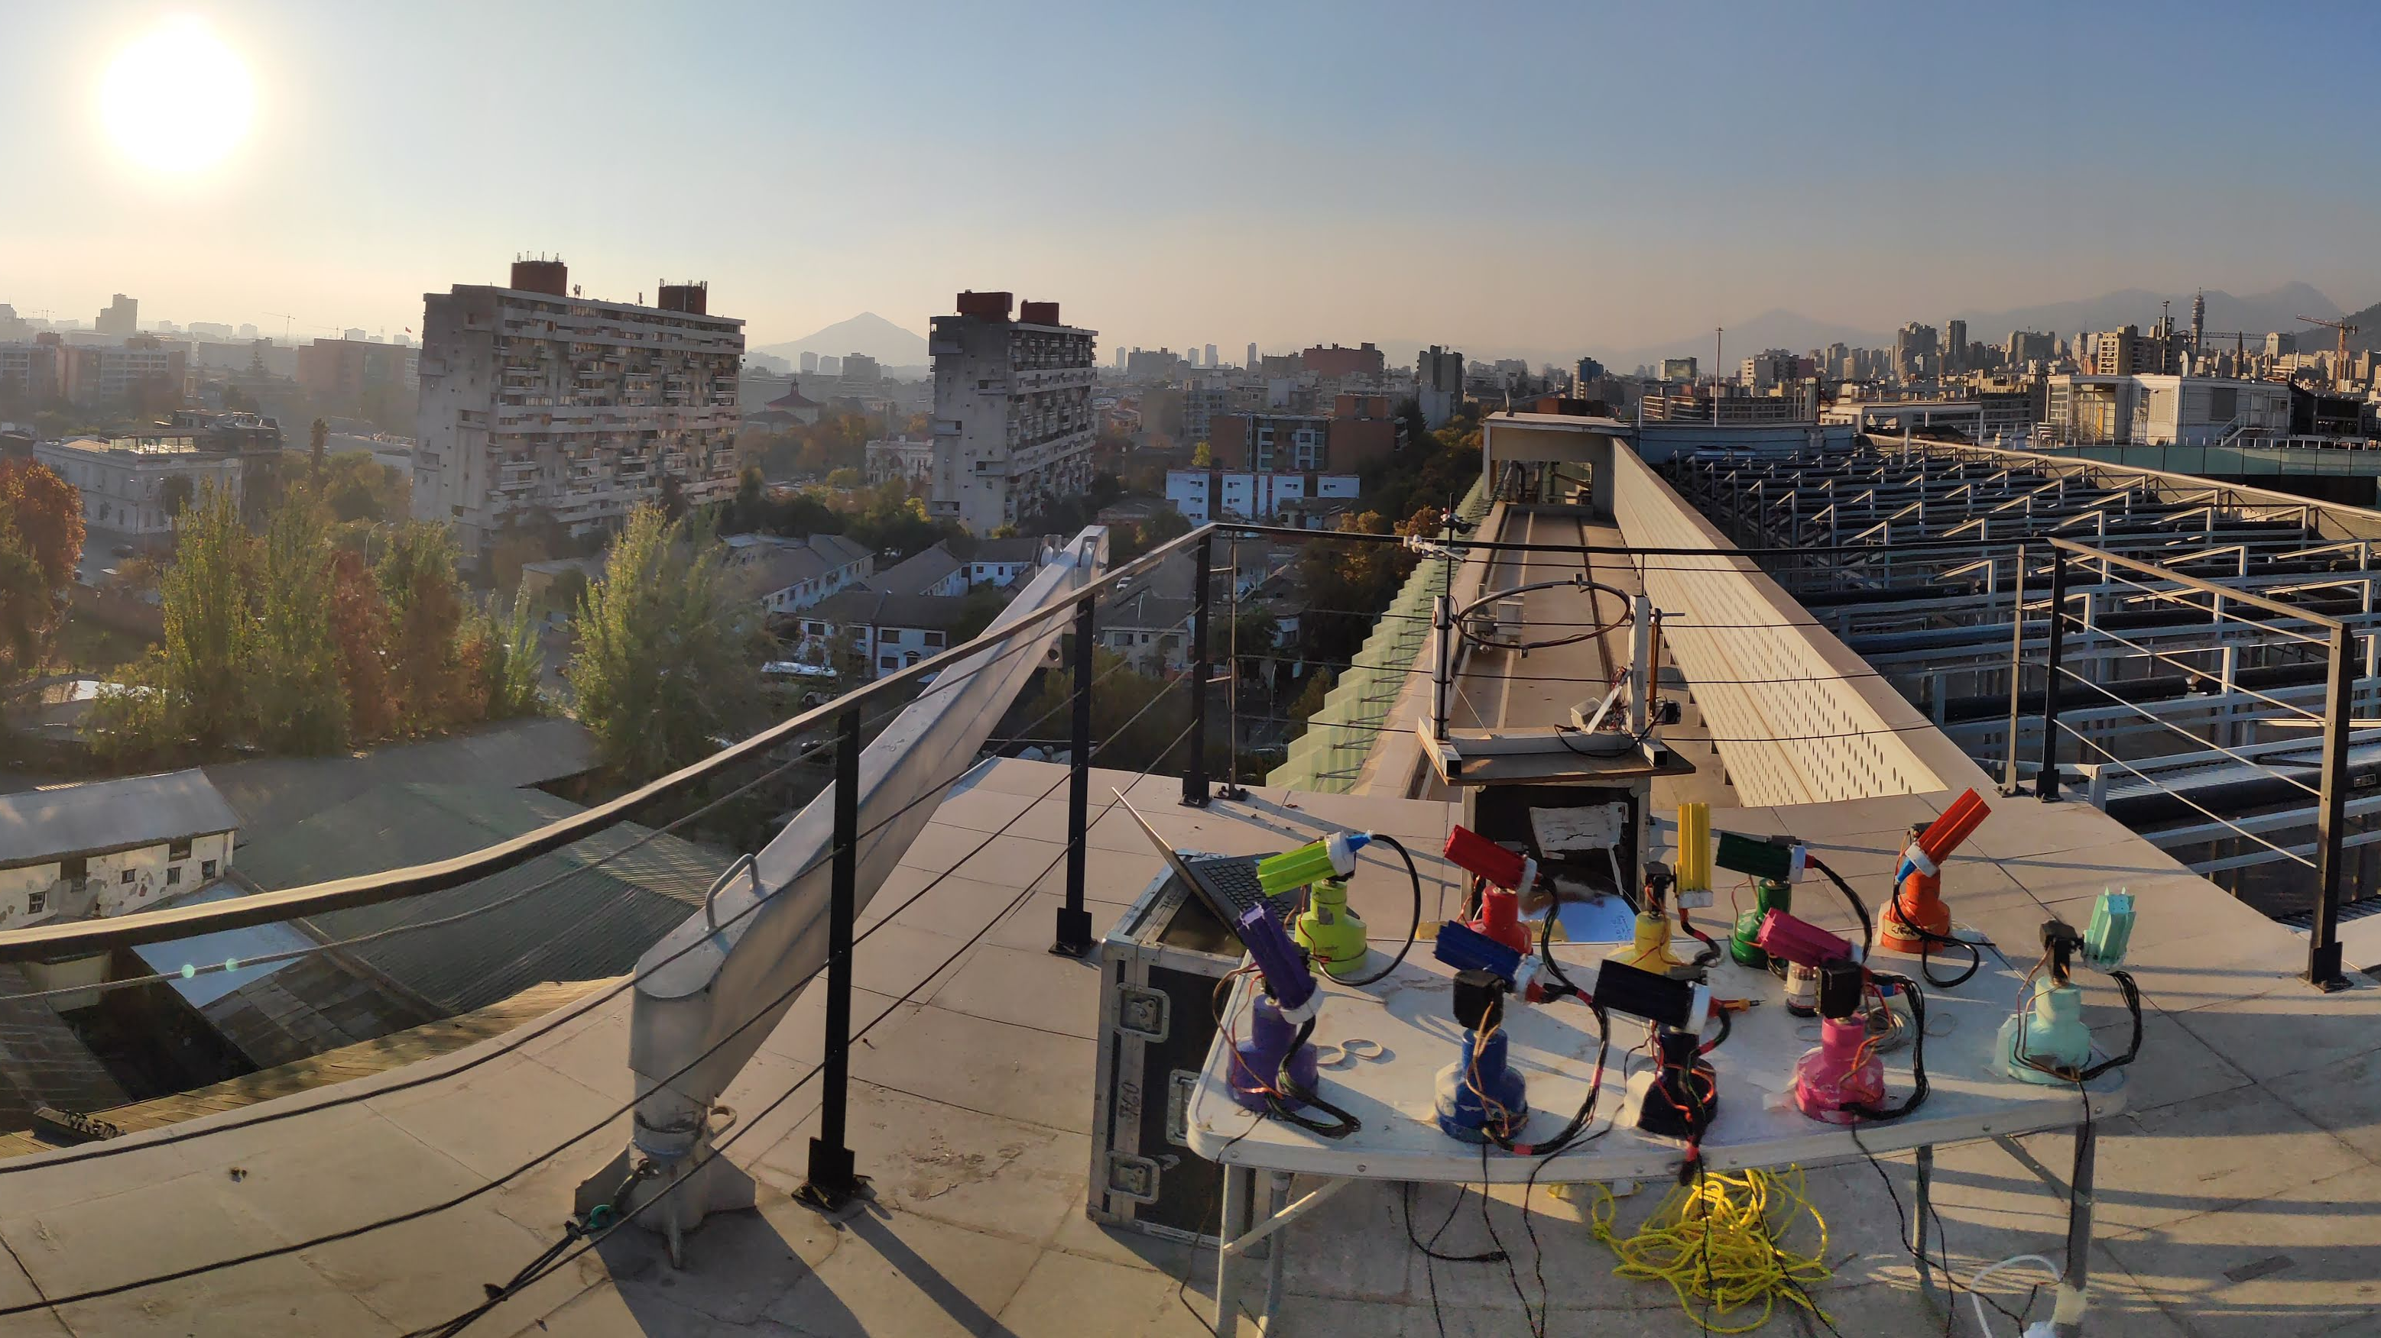
Agenda
Motivation
Objectives
Methodology
Results
Discussion
Conclusion

Slide 3
Motivation

Slide 4
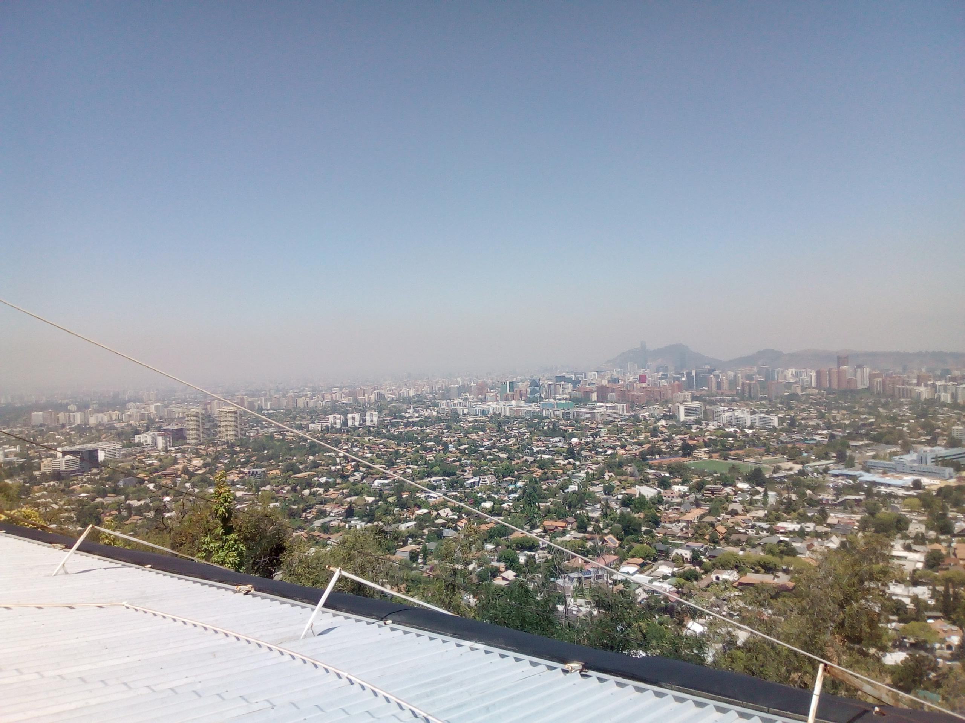
Aerosols
All the solid or liquid particles that are on suspension in the atmosphere.
Aerosols Could be into the atmosphere from some hours to a few weeks.

Slide 5
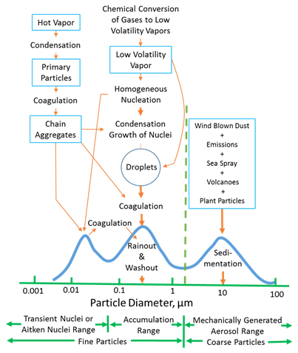
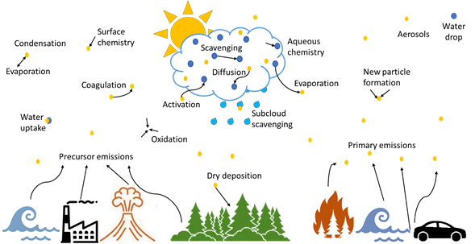
Aerosols

Slide 6
Aerosols
‘All the solid or liquid particles that are on suspension in the atmosphere’
Aerosols Effects:
Health
Visibility
Ecosystems
Cloud Formation and Radiation Budget

Slide 7
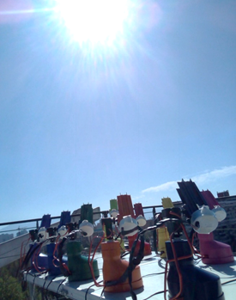
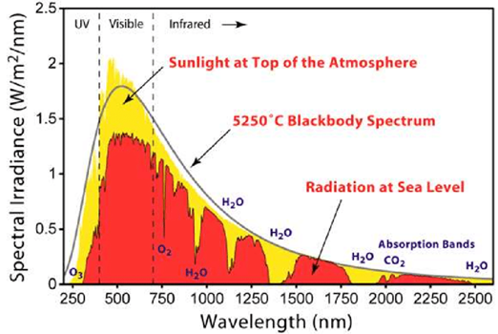
Radiation in the Atmosphere

Slide 8
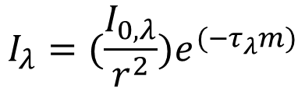
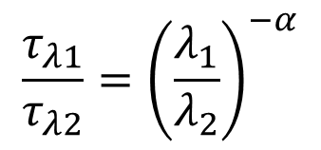
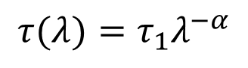
Radiation in the Atmosphere
Beer-Lambert-Bourguer Law
$$I_{λ}=(\frac{I_{0,λ}}{r^{2}})e^{(−τ_{λ}m)}$$
$$τ_{λ}=τ_{λ Rayleigh}+τ_{λ Gases}+τ_{λ Aerosols}$$
Ångström Exponent equation
$$τ(λ)=τ_{1}λ^{−α}$$
$$\frac{τ_{λ1}}{τ_{λ2}}={\left(\frac{λ_{1}}{λ_{2}}\right)}^{−α}$$

Slide 9
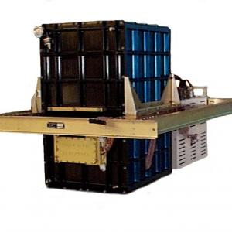
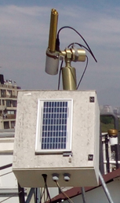
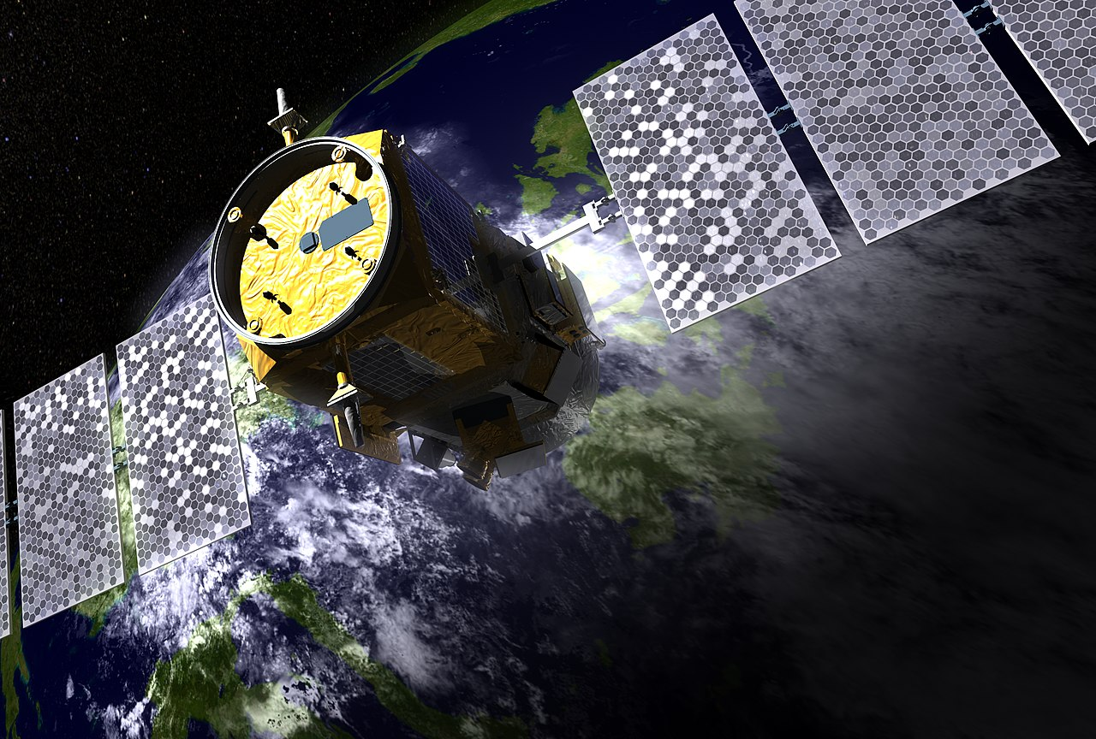
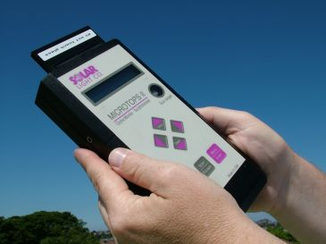
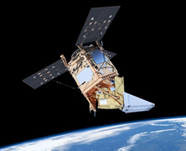
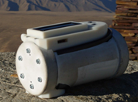
AOD Measurement Instruments
Cloud Physics LIDAR
Satellite LIDAR
Sun Photometer
Handheld
Sun Photometers
Satellite Radiometer

Slide 10
AOD Measurement Instruments
Accuracy
Cloud Physics LIDAR
Satellite LIDAR
Sun Photometer
Time Resolution
Spatial Resolution
Handheld
Sun Photometers
Satellite Radiometer

Slide 11
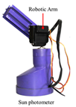
AOD Measurement Instruments
Accuracy
Cloud Physics LIDAR
Satellite LIDAR
Sun Photometer
Time Resolution
Spatial Resolution
Handheld
Sun Photometers
Satellite Radiometer

Slide 12
Objetives

Slide 13
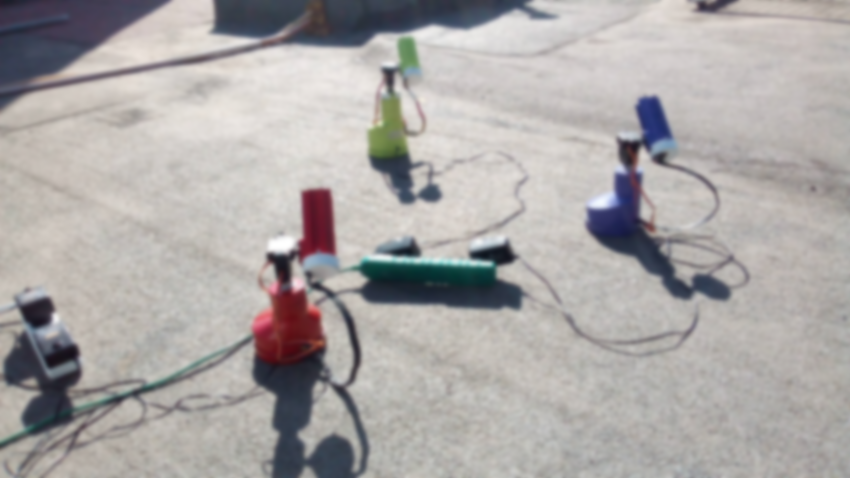
Objectives
Main Objective:
To determinate the feasibility to implement a low-cost, automatic city-scale Sun Photometer Network
Specific Objectives:
To develop, to calibrate and to characterize an instrument prototype.
To manufacture several units and to perform some distributed campaigns at city-scale.
To identify the issues and recommendations for a future implementation of a network.

Slide 14
Methodology

Slide 15
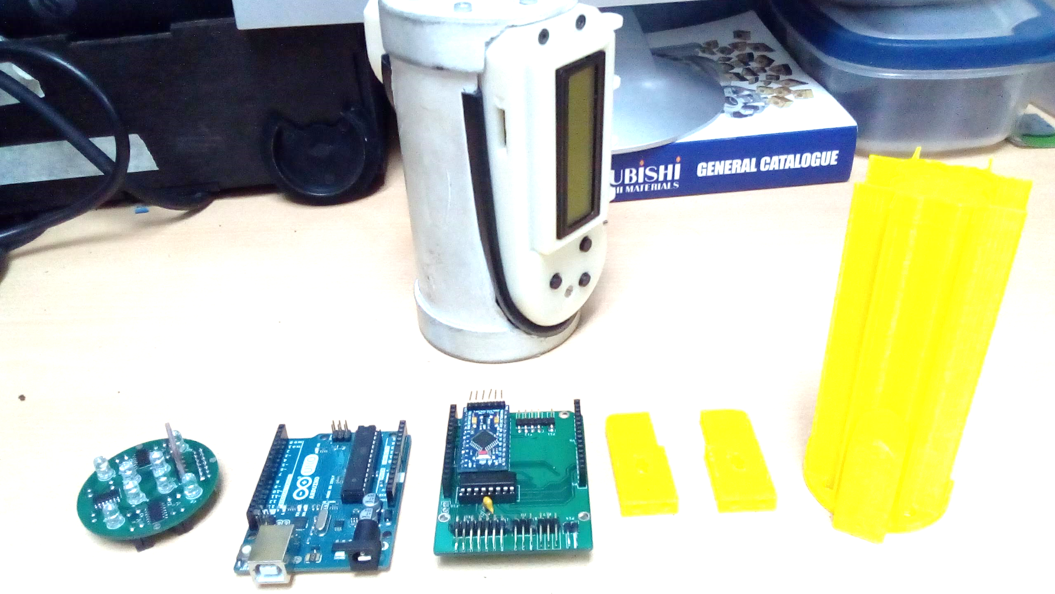
Instrument Development
Conceptual schematic design
&
Subsystems definition
Subsystems prototype
&
testing
Instrument design
Instrument prototype
Instrument Testing
Instrument improvement
Conceptual improvement

Slide 16
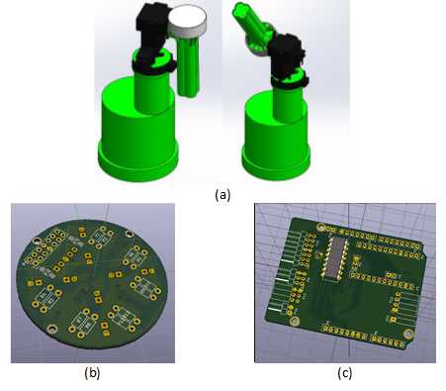
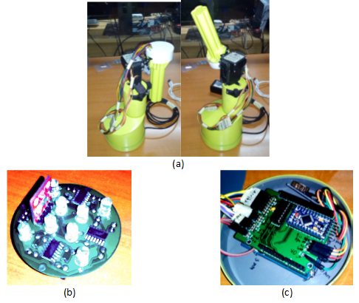
Instrument Development
Conceptual schematic design
&
Subsystems definition
Subsystems prototype
&
testing
Instrument design
Instrument prototype
Instrument Testing
Instrument improvement
Conceptual improvement

Slide 17
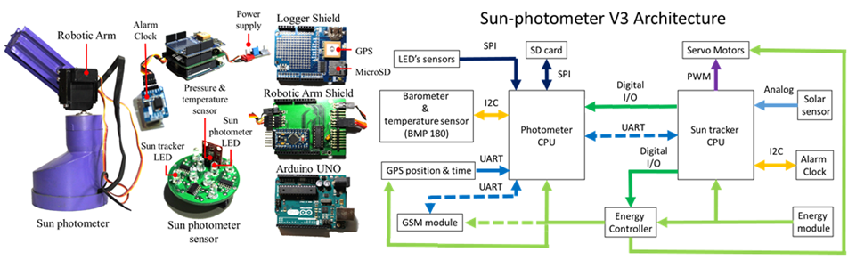
Components of the Sun Photometer

Slide 18
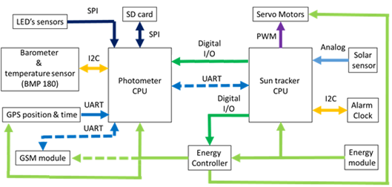
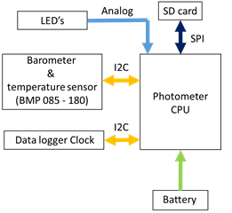
Comparison with Toledo et al. 2018 Sun Photometer
Our Sun Photometer
Toledo et al. 2018 Sun Photometer

Slide 19
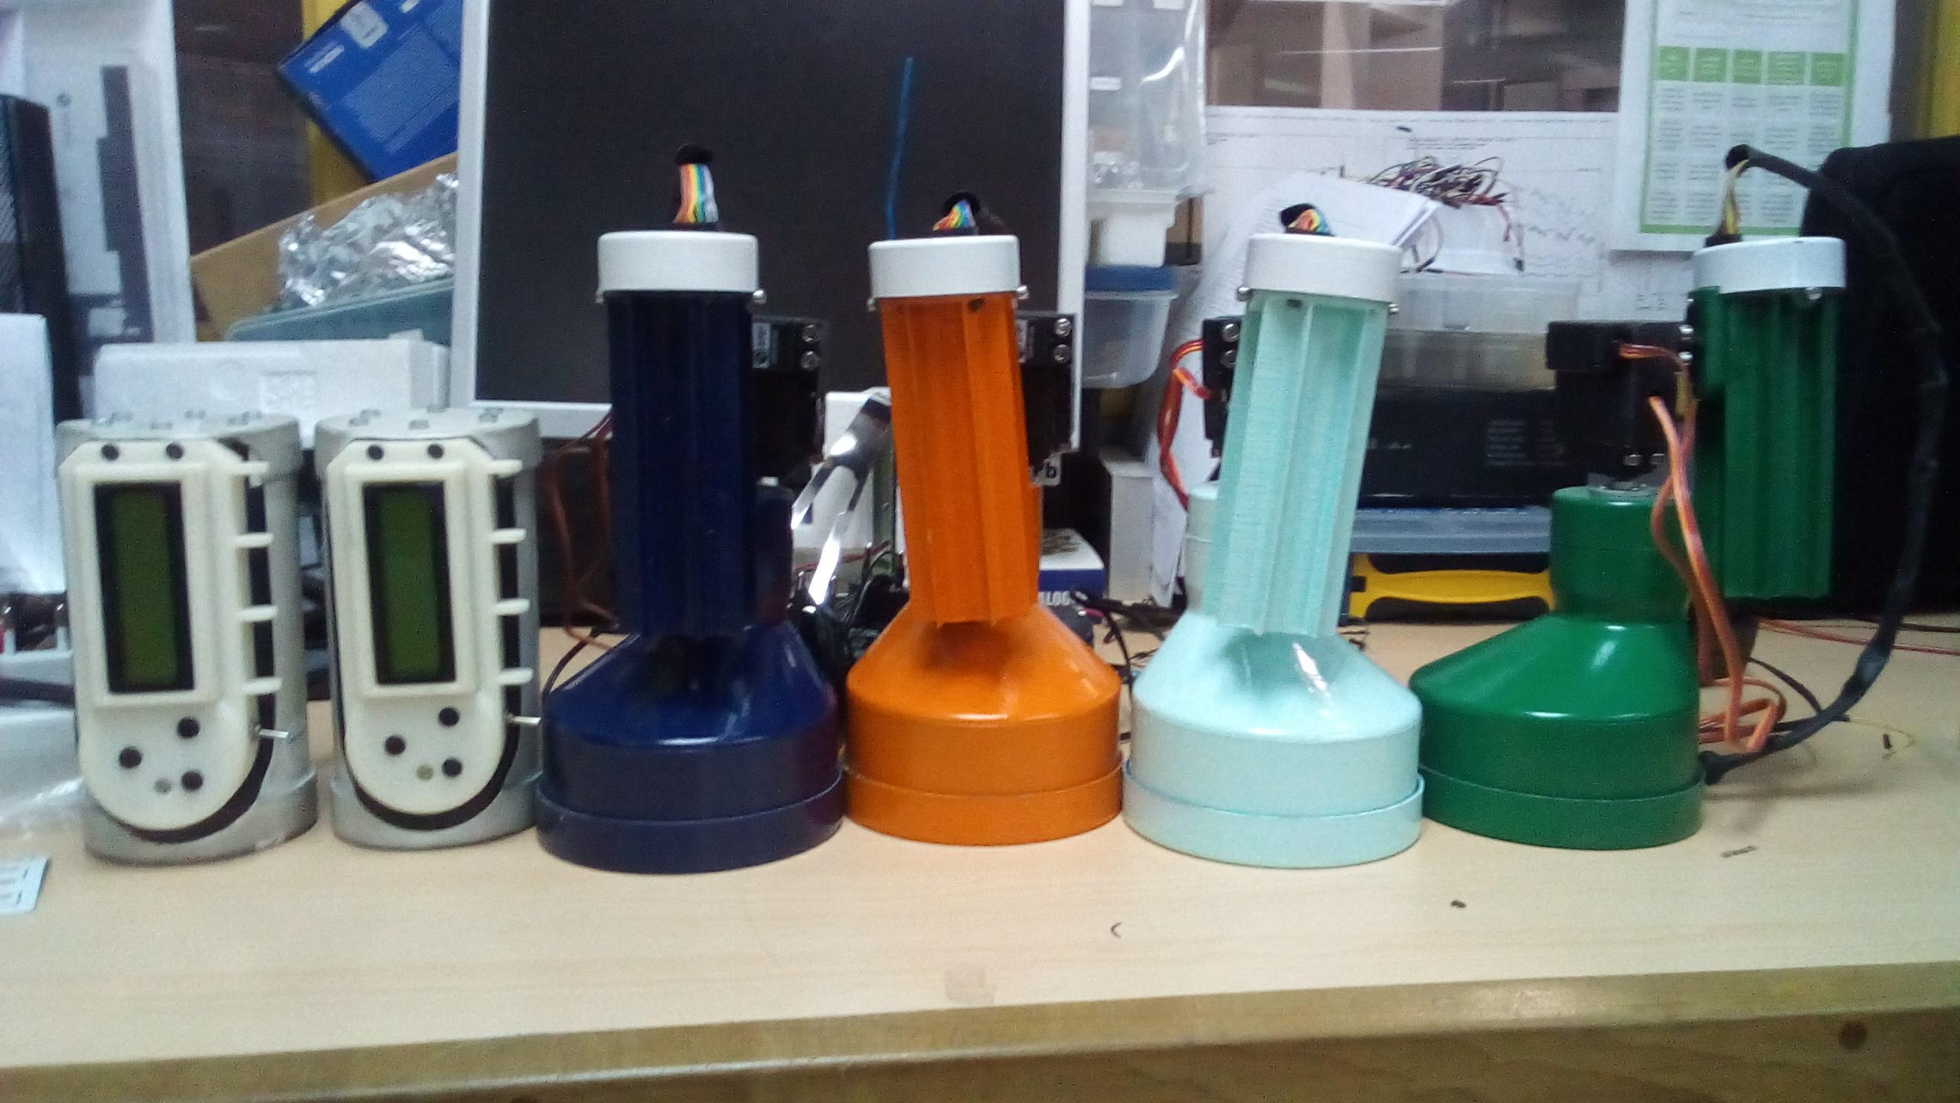
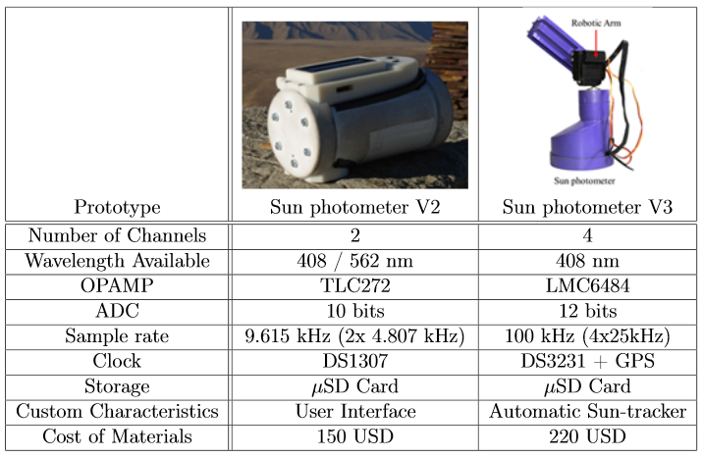
Comparison with Toledo et al. 2018 Sun Photometer

Slide 20
Results

Slide 21
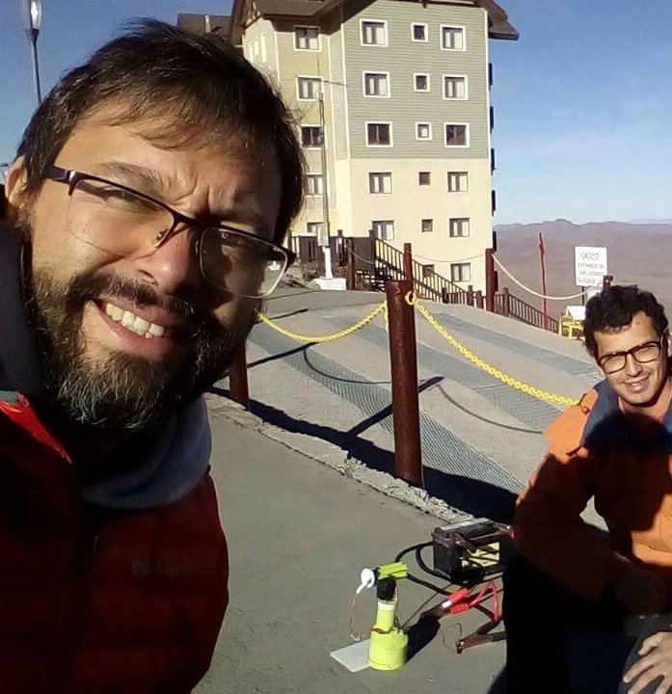
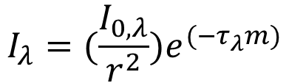
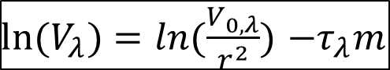
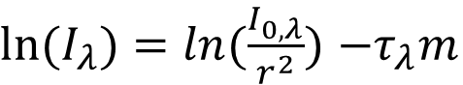
Langley Plot Calibration and Results Comparison
$$I_{λ}=(\frac{I_{0,λ}}{r^{2}})e^{(−τ_{λ}m)}$$
${ln⁡(I}_{λ})=ln(\frac{I_{0,λ}}{r^{2}})$ $−τ_{λ}m$
${ln⁡(V}_{λ})=ln(\frac{V_{0,λ}}{r^{2}})$ $−τ_{λ}m$

Slide 22
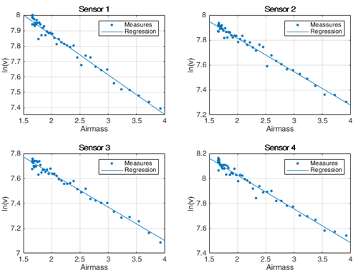
Langley Plot Calibration and Results Comparison
$$I_{λ}=(\frac{I_{0,λ}}{r^{2}})e^{(−τ_{λ}m)}$$
${ln⁡(I}_{λ})=ln(\frac{I_{0,λ}}{r^{2}})$ $−τ_{λ}m$
${ln⁡(V}_{λ})=ln(\frac{V_{0,λ}}{r^{2}})$ $−τ_{λ}m$

Slide 23
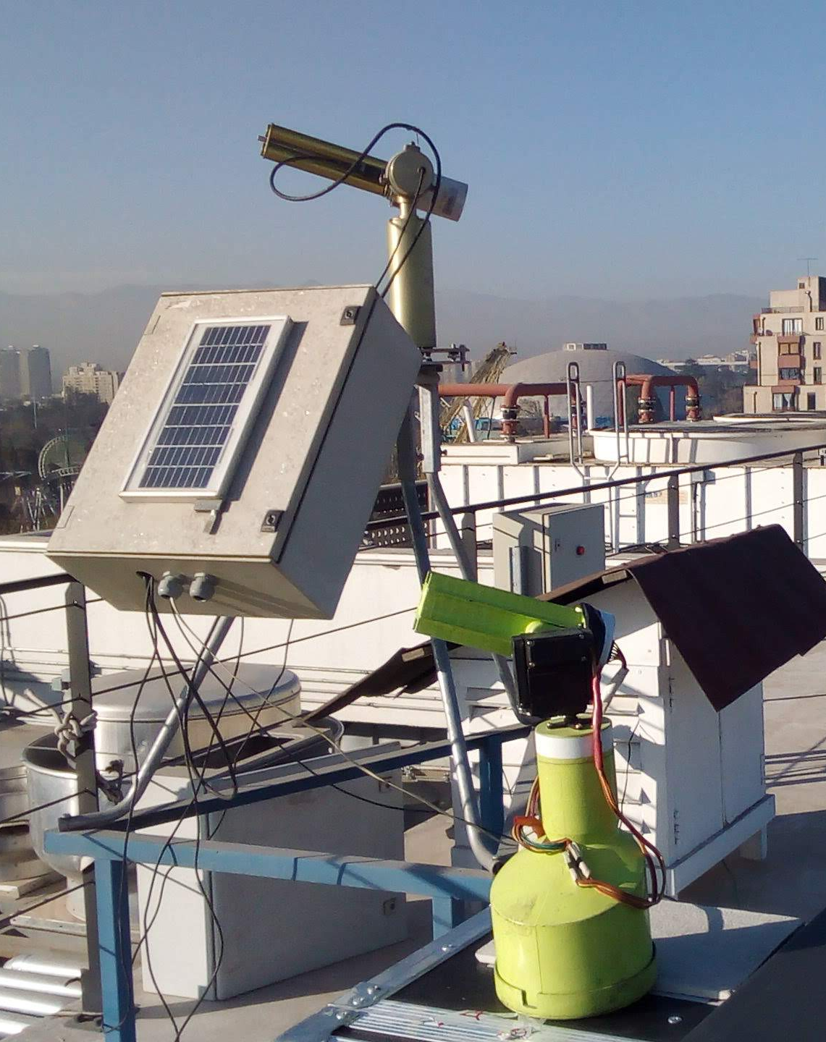
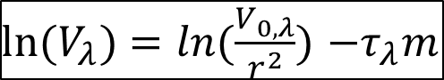
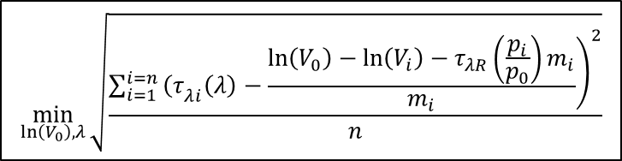
Langley Plot Calibration and Results Comparison
Langley Plot Calibration
${ln⁡(V}_{λ})=ln(\frac{V_{0,λ}}{r^{2}})$ $−τ_{λ}m$
Parameter Fitting Calibration
$$\min_{\ln\left(V_{0}\right), λ}{\sqrt{\frac{\sum_{i=1}^{i=n}{{\left.{\left(τ\right.}_{λi}\left(λ\right)−\frac{\ln\left(V_{0}\right)−\ln\left(V_{i}\right)−τ_{λR}\left(\frac{p_{i}}{p_{0}}\right)m_{i}}{m_{i}}\right)}^{2}}}{n}}}$$

Slide 24
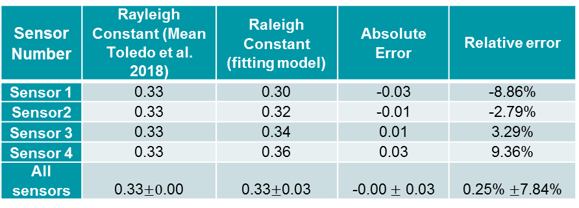
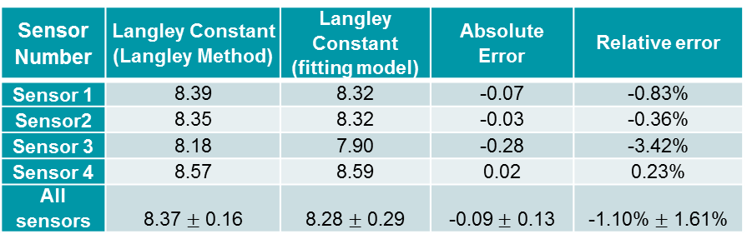
Langley Plot Calibration and Results Comparison
Sensor Number | Langley Constant (Langley Method) | Langley Constant (fitting model) | Absolute Error | Relative error
Sensor 1 | 8.39 | 8.32 | -0.07 | -0.83%
Sensor2 | 8.35 | 8.32 | -0.03 | -0.36%
Sensor 3 | 8.18 | 7.90 | -0.28 | -3.42%
Sensor 4 | 8.57 | 8.59 | 0.02 | 0.23%
All sensors | 8.37 $±$ 0.16 | 8.28 $±$ 0.29 | -0.09 $±$ 0.13 | -1.10% $±$ 1.61%
Sensor Number | Rayleigh Constant (Mean Toledo et al. 2018) | Raleigh Constant (fitting model) | Absolute Error | Relative error
Sensor 1 | 0.33 | 0.30 | -0.03 | -8.86%
Sensor2 | 0.33 | 0.32 | -0.01 | -2.79%
Sensor 3 | 0.33 | 0.34 | 0.01 | 3.29%
Sensor 4 | 0.33 | 0.36 | 0.03 | 9.36%
All sensors | 0.33$±0$.00 | 0.33$±$0.03 | -0.00 $±$ 0.03 | 0.25% $±$7.84%

Slide 25
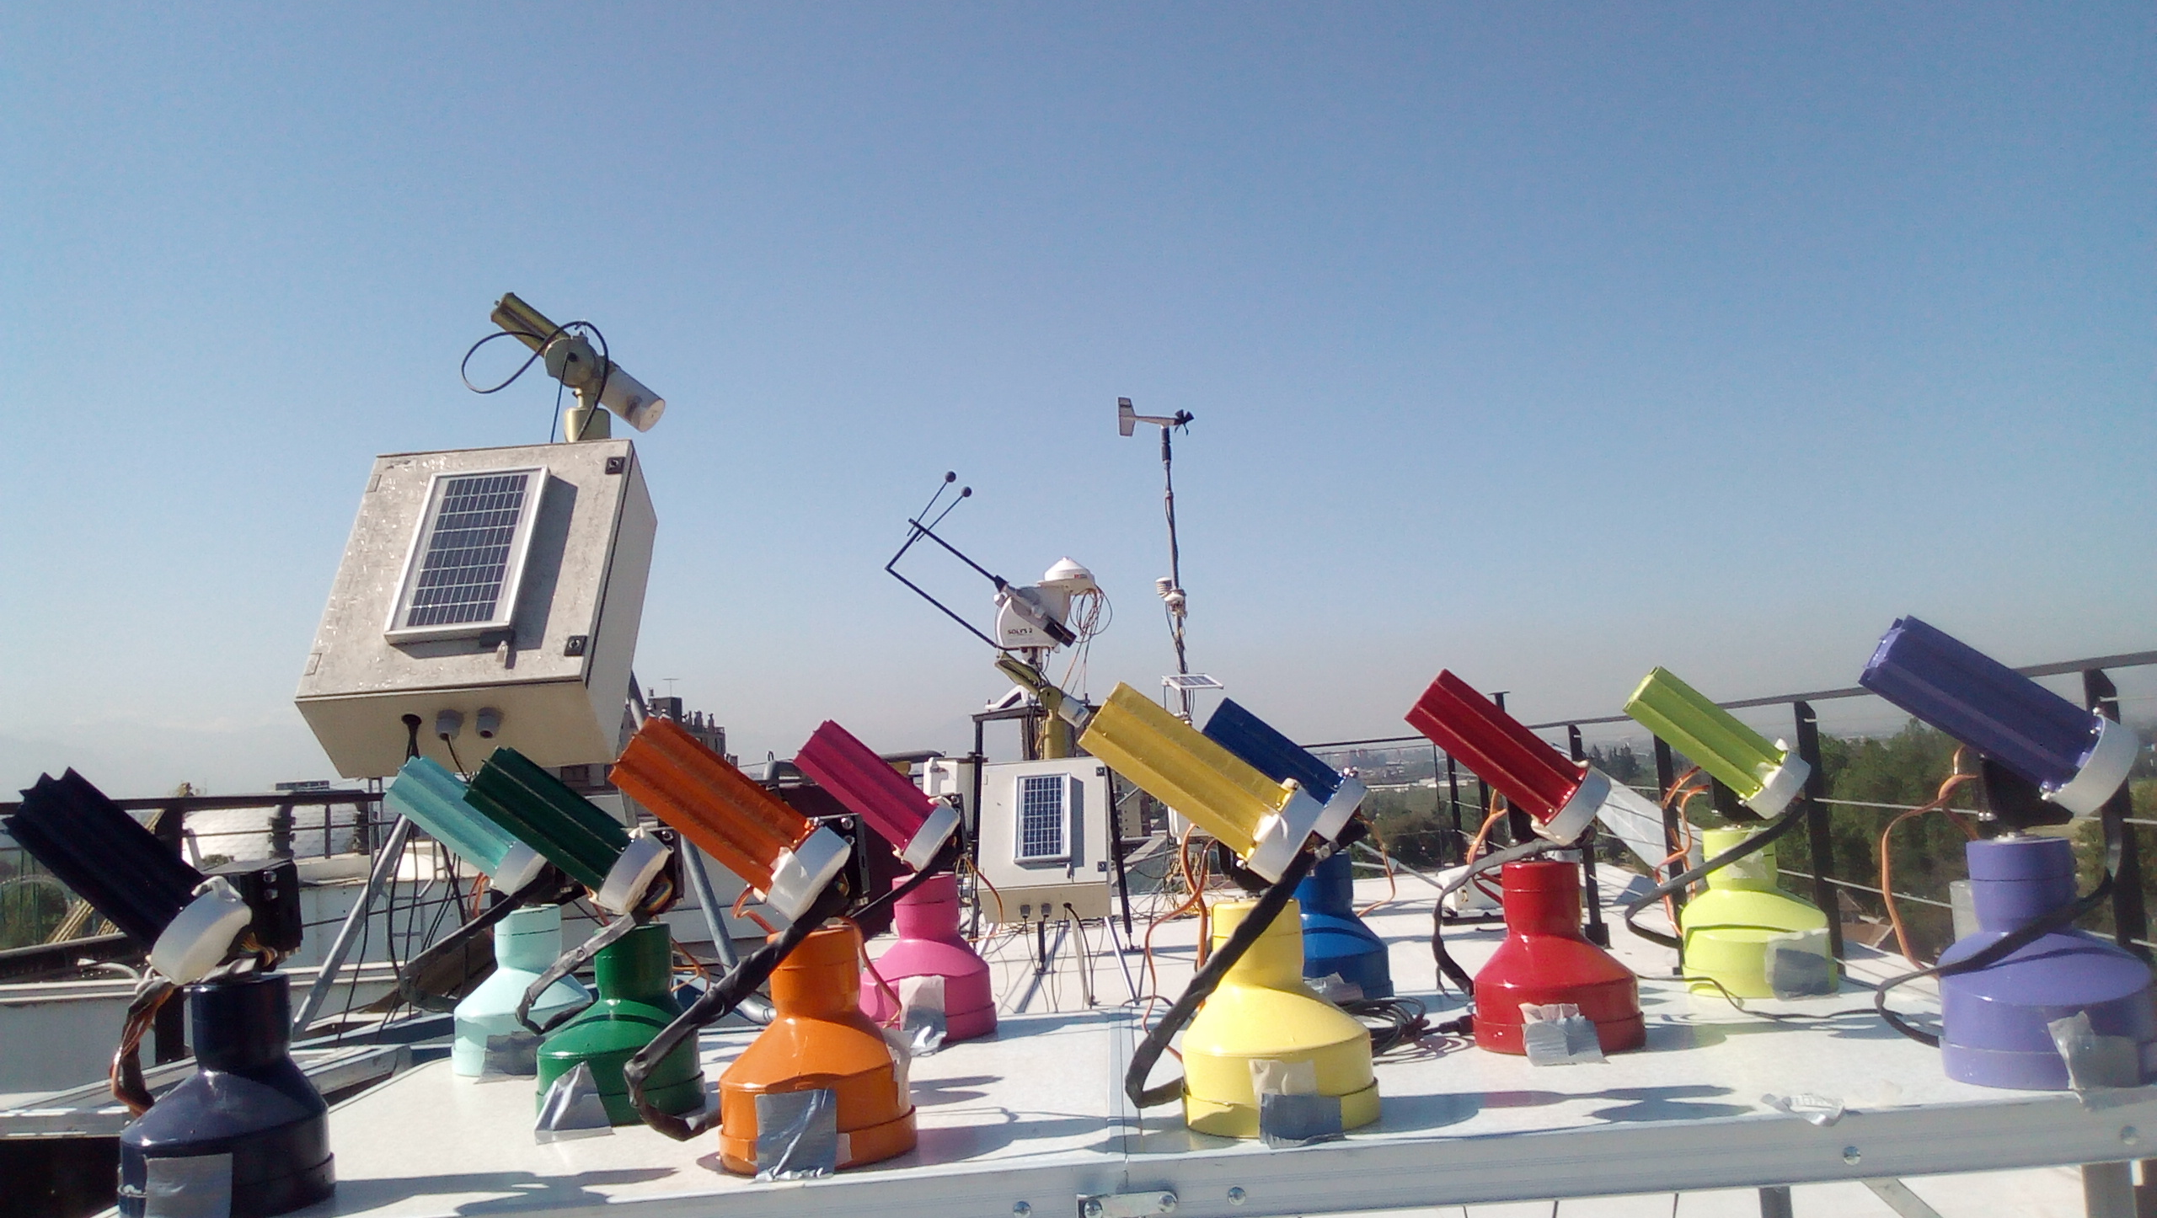
Measurements errors Characterization

Slide 26
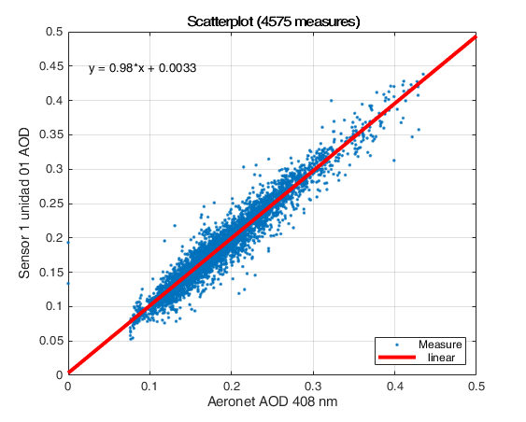
Measurements errors Characterization
Valid Calibration Measures | Mean Number of Measures | Average difference Cimel and our Instruments | Mean Standard deviation difference Cimel and our Instruments
50,908 | 1340 | 0.0002 | 0.021

Slide 27
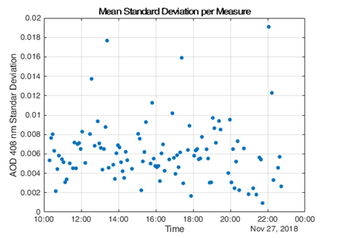
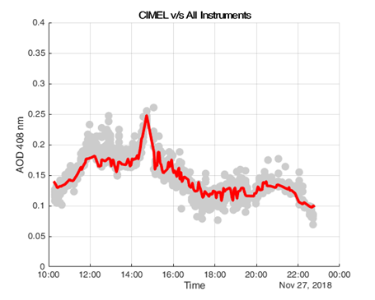
Measurements errors Characterization
Bias CIMEL v/s All Instruments (Calibration) | Bias CIMEL v/s All Instruments (Independent)
0.0008 | -0.0017
Mean Standard Deviation All Instruments (Calibration) | Mean Standard Deviation All Instruments (Independent)
0.0064 | 0.0062

Slide 28
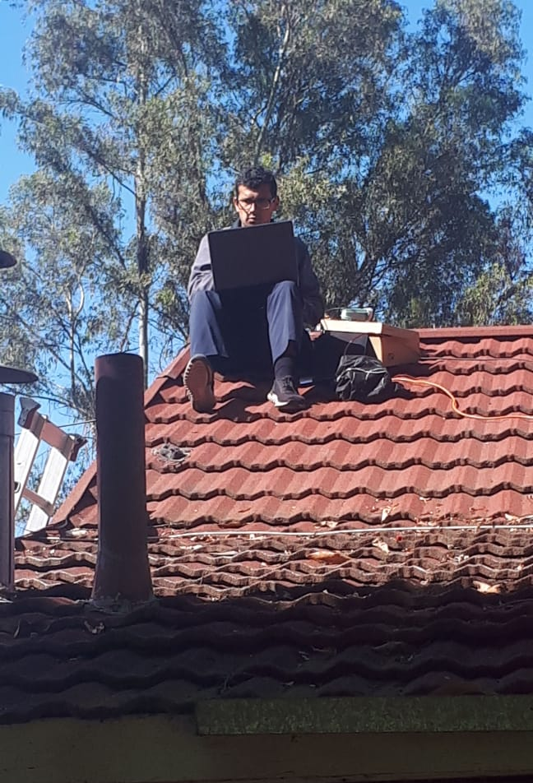
Measurement Campaigns
July 30th, 2018 (2 Instruments)
December 12th, 2018 (3 Instruments)
January 11th , 2019 (3 Instruments)
January 18th, 2019 (5 Instruments)
January 19th, 2019 (6 Instruments)
January 21st, 2019 (6 Instruments)
January 23rd, 2019 (6 Instruments)

Slide 29
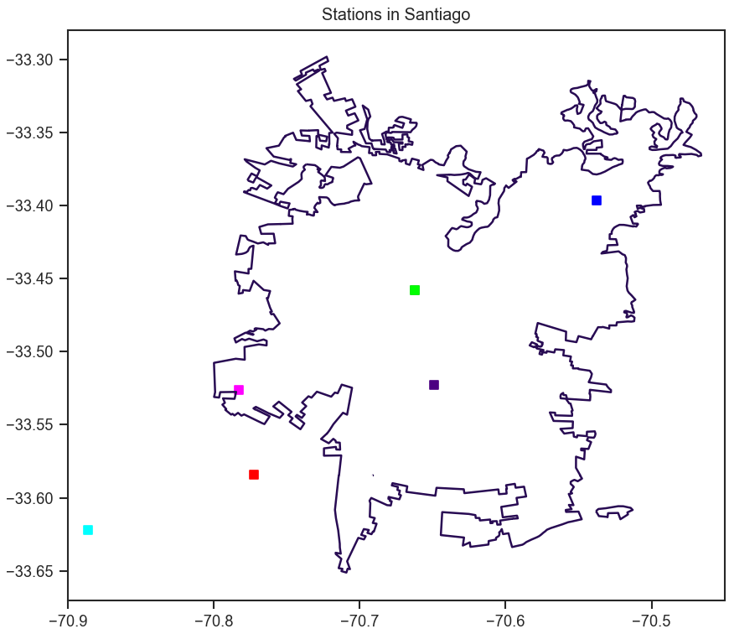
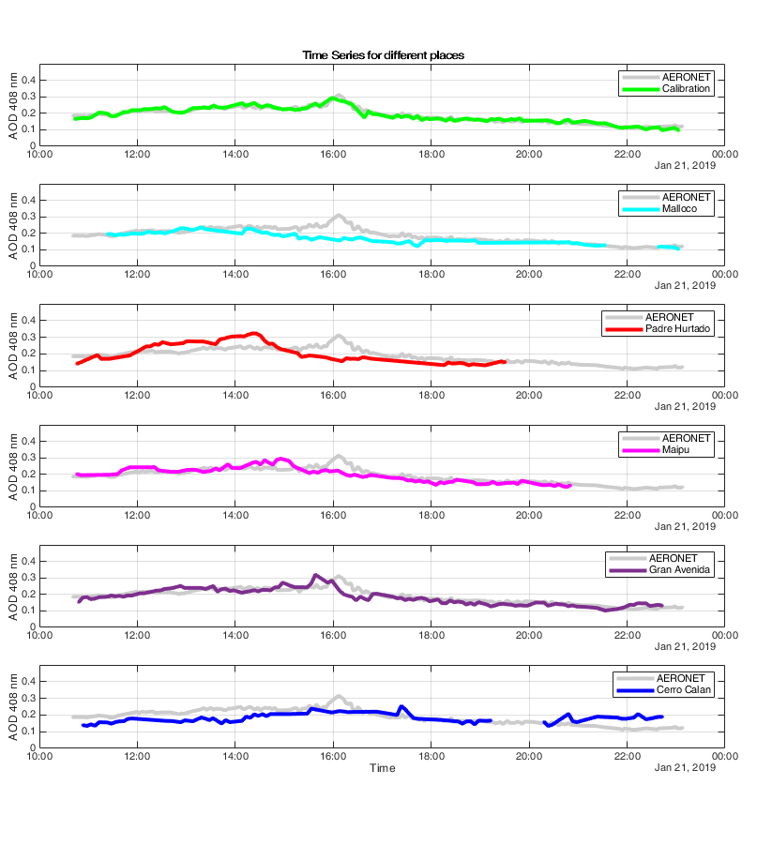
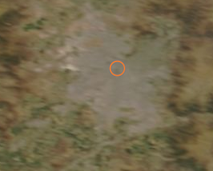
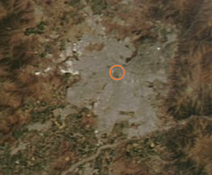
Measurement Campaigns
Terra
Aqua

Slide 30
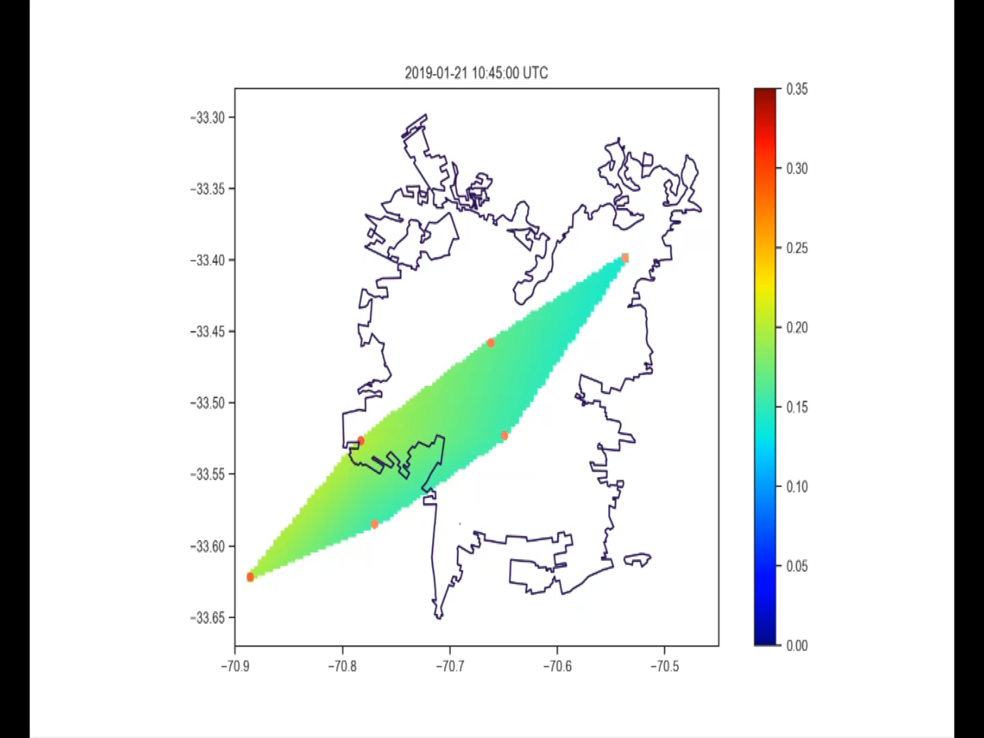
Measurement Campaigns

Slide 31
Discussion

Slide 32
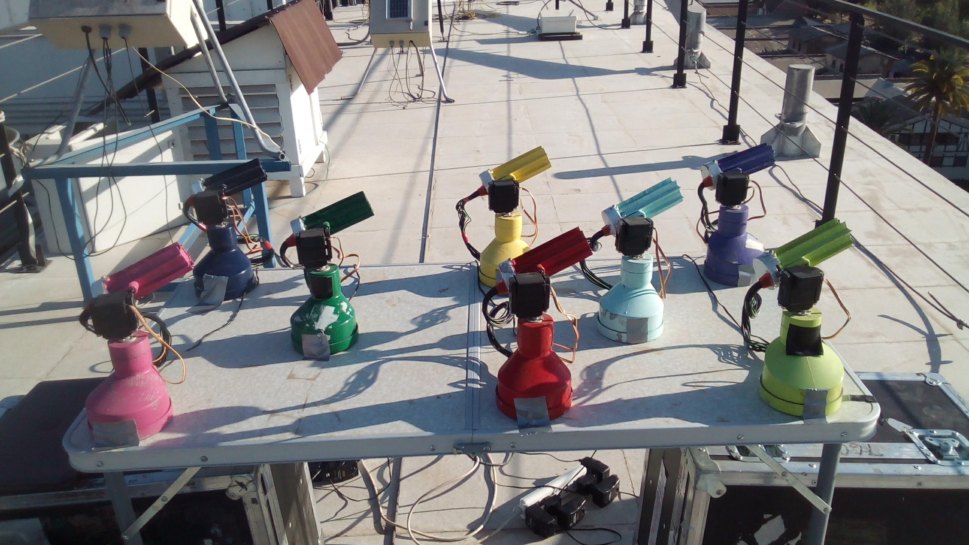
Instrument Calibration and Consistency
Our results show a mean standard deviation of 0.021 between our instruments and the AERONET Cimel.
In addition the mean error for all our sensors for the same time and place are always under 0.02 (0.006 in average).
All the previous experiments uses the sensors considering a near calibration. However, we do not know the error of different calibrations for the same instruments.

Slide 33
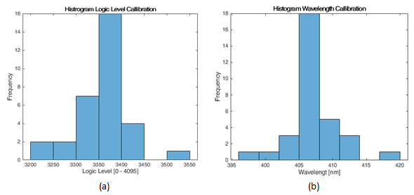
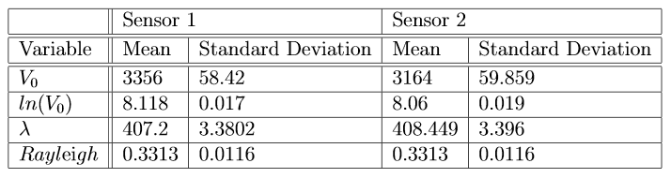
Instrument Calibration and Consistency

Slide 34
Instrument Calibration and Consistency

Slide 35
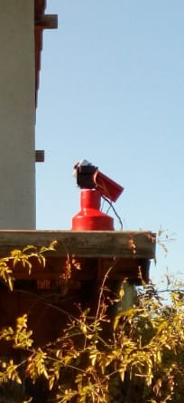
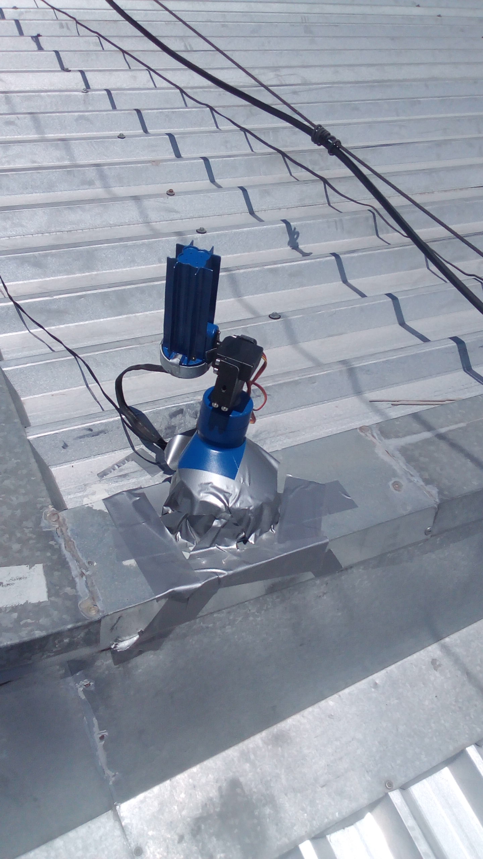


Distributed Measurements
The results of the campaigns exhibit a rich dynamical behavior of AOD.
The measures show a displacement of aerosols from the south-west to the North East of the city. That is consistent with some wind models.
Other measures displays different behaviors for different stations to similar distances from the AERONET Cimel instruments, showing that this is not representative of the city.
Data presents that the rich changing in AOD is into the city.

Slide 36

Challenges and Future Considerations
The Ångström exponent (usually between 0 and 2) estimation would be possible with enough accuracy only if we consider 4 wavelengths with the same error (error estimation around 0.0458). With 2 bands the error estimation is around 0.8 for the mean conditions of Santiago.

Slide 37
Challenges and Future Considerations
There are some improvements suggested for future versions of the instrument:
Including a Check out routine
Consider build a waterproof instrument
Change the Servo motors
Improve the connection cable between the sensor and the instrument

Slide 38
Conclussion

Slide 39

Conclusion
We have developed, calibrated and to characterized an instrument prototype. The standard deviation among all the instruments after calibration is under 0.02 and the mean error with the Cimel Sun photometer is of 0.021.
We built several Units and performed a city-scale campaign, showing the rich behavior of AOD in urban areas.
We have identified issues in the calibration process and considerations for future versions to extend the capabilities of the instrument and their robustness.
In essence, We have shown the feasibility to implement a low-cost, automatic and city-scale LED-based Sun Photometer Network.

Slide 40
Thank you!
Santiago de Chile, June 19th, 2020
Cristóbal Garrido Cáceres

Slide 41
Bibliography
Dayou, J., Chang, J. H. W., & Sentian, J. (2014). Ground-Based Aerosol Optical Depth Measurement Using Sunphotometers. Springer.
King, M. D., Byrne, D. M., Herman, B. M., & Reagan, J. A. (1978). Aerosol size distributions obtained by inversions of spectral optical depth measurements. Journal of the Atmospheric Sciences, 35(11), 2153-2167.
Schuster, G. L., Dubovik, O., & Holben, B. N. (2006). Angstrom exponent and bimodal aerosol size distributions. Journal of Geophysical Research: Atmospheres, 111(D7).

Slide 42
Bibliography
Holben, B. N., Eck, T. F., Slutsker, I., Tanre, D., Buis, J. P., Setzer, A., ... & Lavenu, F. (1998). AERONET—A federated instrument network and data archive for aerosol characterization. Remote sensing of environment, 66(1), 1-16.
Holben, B. N., Kim, J., Sano, I., Mukai, S., Eck, T. F., Giles, D. M., ... & Sorokin, M. (2018). An overview of mesoscale aerosol processes, comparisons, and validation studies from DRAGON networks. Atmospheric Chemistry and Physics, 18(2), 655-671.
Liu, B., Ma, Y., Gong, W., Zhang, M., Wang, W., & Shi, Y. (2018). Comparison of AOD from CALIPSO, MODIS, and Sun Photometer under Different Conditions over Central China. Scientific reports, 8(1), 10066.

Slide 43
Bibliography
Toledo, F., Garrido, C., Díaz, M., Rondanelli, R., Jorquera, S., & Valdivieso, P. (2018). AOT Retrieval Procedure for Distributed Measurements with Low‐Cost Sun Photometers. Journal of Geophysical Research: Atmospheres, 123(2), 1113-1131.
Brooks, D. R., & Mims, F. M. (2001). Development of an inexpensive handheld LED‐based Sun photometer for the GLOBE program. Journal of Geophysical Research: Atmospheres, 106(D5), 4733-4740.
Wallace, J. M., & Hobbs, P. V. (2006). Atmospheric science: an introductory survey (Vol. 92). Elsevier.
Seinfeld, J. H., & Pandis, S. N. (2006). Atmospheric chemistry and physics: From air pollution to climate change, John Willey & Sons. Inc., New York.

Slide 44
Bibliography
Ghan, S. J., & Schwartz, S. E. (2007). Aerosol properties and processes: A path from field and laboratory measurements to global climate models. Bulletin of the American Meteorological Society, 88(7), 1059-1084.
Cengel, Y. (2014). Heat and mass transfer: fundamentals and applications. McGraw-Hill Higher Education.
Liou, K. N. (2002). An introduction to atmospheric radiation (Vol. 84). Elsevier.
Hansen, J. E., & Travis, L. D. (1974). Light scattering in planetary atmospheres. Space science reviews, 16(4), 527-610.
Weitkamp, C. (Ed.). (2006). Lidar: range-resolved optical remote sensing of the atmosphere (Vol. 102). Springer Science & Business.

Slide 45
Bibliography
Perri, M. J., Haggmark, M. R., Silva, D. R., & Mohs, R. M. (2016). Inexpensive Automated Atmospheric Measurements of Aerosol Optical Thickness, Ozone, and Temperature. Aerosol and Air Quality Research, 16(2), 464-469.
Toledano, C., González, R., Fuertes, D., Cuevas, E., Eck, T. F., Kazadzis, S., ... & Román, R. (2018). Assessment of Sun photometer Langley calibration at the high-elevation sites Mauna Loa and Izaña. Atmospheric Chemistry and Physics, 18(19), 14555-14567.
Reda, I., & Andreas, A. (2004). Solar position algorithm for solar radiation applications. Solar energy, 76(5), 577-589.
Ångström, A. (1929). On the atmospheric transmission of sun radiation and on dust in the air. Geografiska Annaler, 11(2), 156-166.

Slide 46
Bibliography
Schuster, G. L., Dubovik, O., & Holben, B. N. (2006). Angstrom exponent and bimodal aerosol size distributions. Journal of Geophysical Research: Atmospheres, 111(D7).
Schmitz, R. (2005). Modelling of air pollution dispersion in Santiago de Chile. Atmospheric Environment, 39(11), 2035-2047.
Wagner, F., & Silva, A. M. (2008). Some considerations about Ångström exponent distributions. Atmospheric Chemistry and Physics, 8(3), 481-489.
Bucholtz, A. (1995). Rayleigh-scattering calculations for the terrestrial atmosphere. Applied Optics, 34(15), 2765-2773.

Slide 47
Bibliography
Dubovik, O., & King, M. D. (2000). A flexible inversion algorithm for retrieval of aerosol optical properties from Sun and sky radiance measurements. Journal of Geophysical Research: Atmospheres, 105(D16), 20673-20696.

